Slide 1

EventBuddy
Rohan Singh
Axis8JFSB811

Slide 2
Problem Deﬁnition
Colleges often conduct various events from time to time. Example. A TEDx event, etc.
The problem here is that they don’t have their own platform where a college can manage all their events with ease and students can be informed about the various events that are coming up and get them registered and manage at one place.
Thus, EventBuddy is a platform that can solve the above problem and make the management easier.

Slide 3
Proposed Solution
A website where admins can create events. A student can come and view all the listed
events and schedule for the same and can register himself in the event in which he/she is interested.

Slide 4
Technologies Used
Backend Database
Frontend
Tools
: Java, Spring Boot Microservices
: MongoDB
: HTML CSS JS/Bootstrap
:IntelliJ Idea, Postman (for testing API)
Eureka Server & Client
REST Template
Swagger UI

Slide 5
SERVICES
Student Service
Event Service
Service Registry
(Eureka Server)
Swagger UI
: PORT 8002 CRUD Operations
: PORT 8001 CRUD Operations
: PORT 8761
:PORT 8006

Slide 6
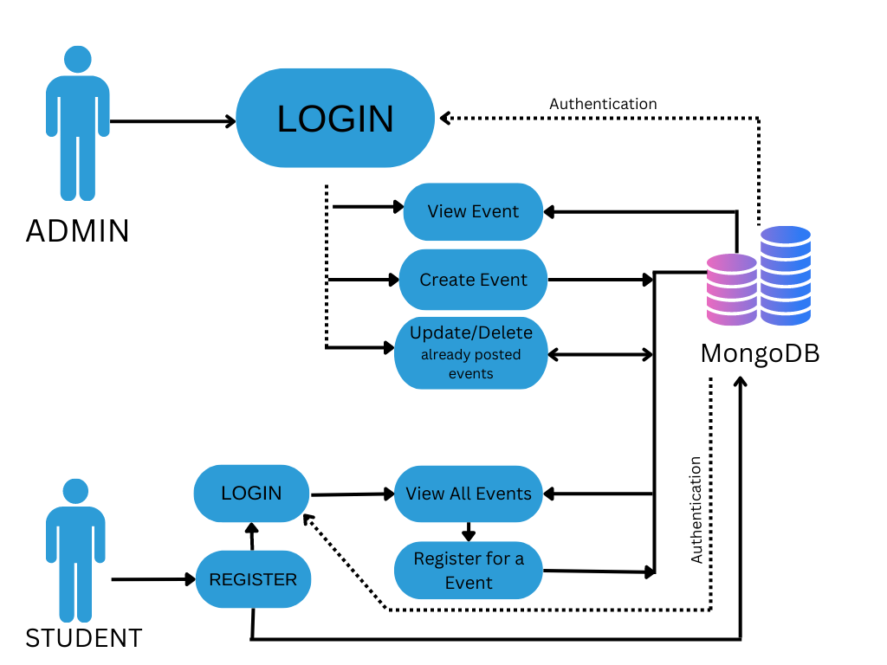
Proposed Solution Flow Diagram

Slide 7
What’s Next & Future Scope
Enhance and Implement using React - Bootstrap
Can allow Admin to make multiple admins
Set notifications of event details.
Can Implement Mail method

Slide 8
Would like to thank
Our trainer Syed Sir for his guidance.
Also Thank
Ronak Sir, UNext & Manipal Team.
LIVE DEMO Next

